Slide 1
Flight Price Prediction Project
Flight Price Prediction
By Akash Pandey

Slide 2
Problem statement
Anyone who has booked a flight ticket knows how unexpectedly the prices vary. The cheapest available ticket on a given flight gets more and less expensive over time. This usually happens as an attempt to maximize revenue based on -
1. Time of purchase patterns (making sure last-minute purchases are expensive)
2. Keeping the flight as full as they want it (raising prices on a flight which is filling up in order to reduce sales and hold back inventory for those expensive last-minute expensive purchases)

Slide 3
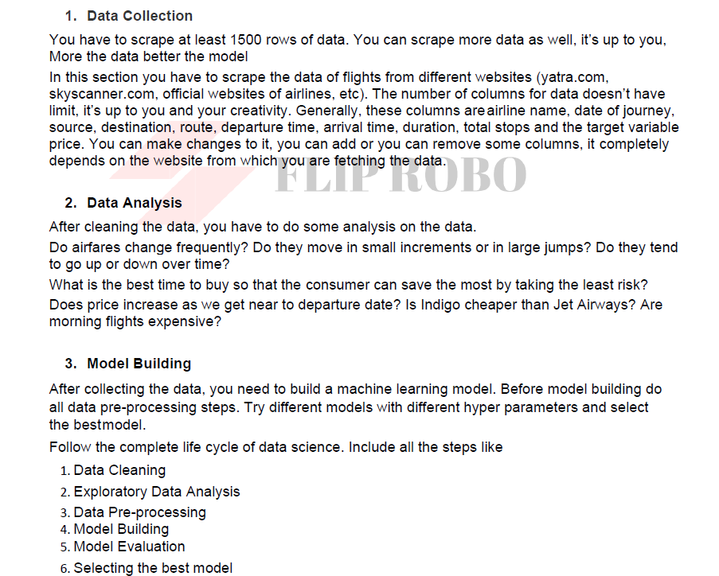
Business Goal & Technical requirement

Slide 4
Steps taken
Identified that this is a regression problem and we have to build a regression model to predict the price.
Data was cleaned during data mining.
Data Visualization helped us to understand the relationship between each feature against the target variable

Slide 5
Steps taken
Following process was followed to clean the data
1. We can see that arrival time for some of the flights was not updated correctly. Some of the flights along with the arrival time date is also mentioned. We separated the date using the split command.
2. The destination/source value was changed from a city name to the city code. Since Route columns has city code updated. This will help machine to understand both the source and the route correctly.
3. The total duration was changed into minutes. For that first we had splitted the 'h' and 'm' from the columns and separated the hour and minutes columns.
4. We made column for each route the flights take. We named this as a Via points.
5. From the Date of Journey column we extracted the month.

Slide 6
Steps taken
6. The time was changed to early morning, morning, Noon, Eve and Night. For that we created the function and apply while creating the new column.
7. Seasons plays an important role in determining the flight price. We all know that flight price will be high during summer and Winter vacations. Generally the fares are lower during the monsoon.
Hence we created a new column as Season and named it High, Low and Shoulder season depending on the month the flight was operating.
8. Each station was assigned with the same numeric value across each columns. e.g. AMD will have a numeric value 1 each column if AMD is there.
This will help machine to understand the correct source, destination and via points

Slide 7
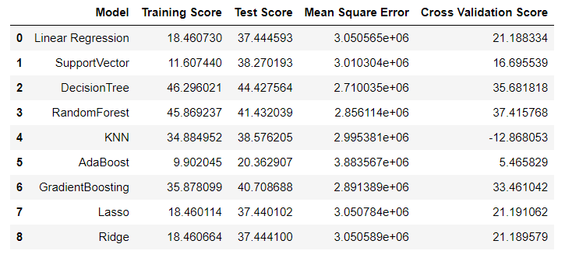
Model Selection
We used various algorithm to train the model. However the model was selected based on the difference between test r2 score and cross validation score.
We selected GradientBoosting Regressor based on the performance.

Slide 8
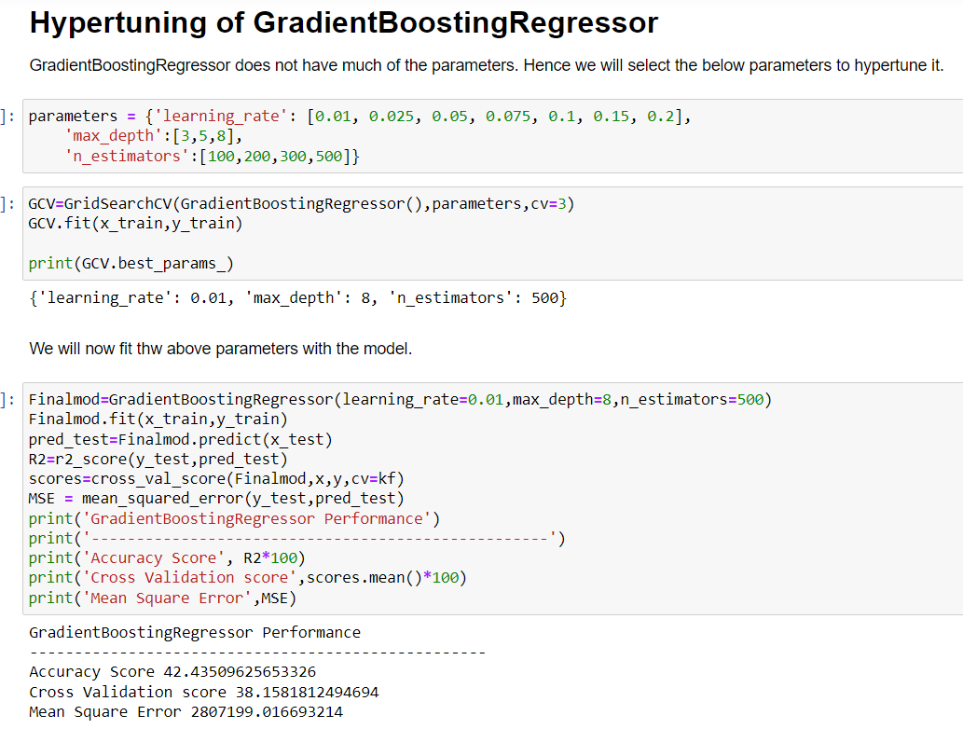
Hyper Tuning
The model accuracy improved slightly after Hypertuning the model

Slide 9
Conclusion
KEY FINDINGS AND CONCLUSIONS OF THE STUDY
In this project we have tried to show how the flights prices vary and what are the factors related to the changing of cars prices. The best was selected using R2 metrics and cross validation score.

